Slide 1
Robo-Recommender: Netflix & Amazon Style Personalised Recommendation Service for Restaurants

Slide 2
Problem
Current establishment choices from review sites e.g Yelp, JustEat, Opentable, FourSquare have only basic levels of personalisation based on either reviews, locality, type of food, price.
Restaurant Owners do not have time to market their business (Only 10% are able to do this) and hence improve turnover and profit.
Reviews Often do not match the dining experience - One persons 5* may be someone else’s 2*. This varies between review sites.
94% of restaurant choices are influenced by online reviews

Slide 3
Solution
API for Hybrid Recommender System for Restaurants combining collaborative and content based filtering.
Integration into Desktop and Mobile Sites. Upto 73% use mobile device for bookings.
Decrease the time spent searching for relevant establishments

Slide 4

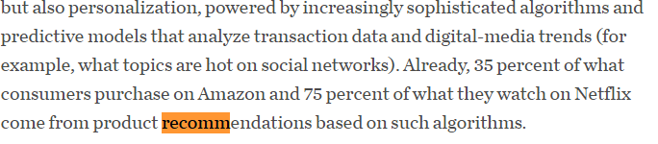

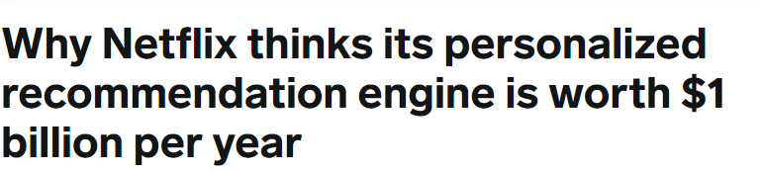
Market Validation

Slide 5
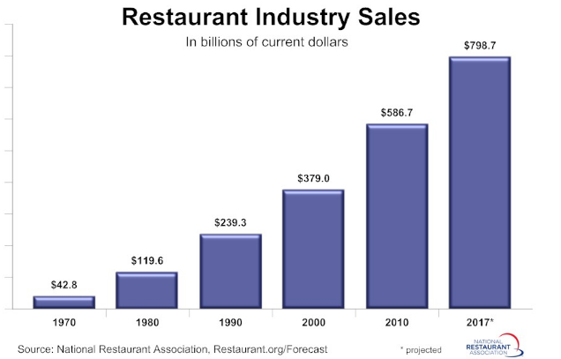
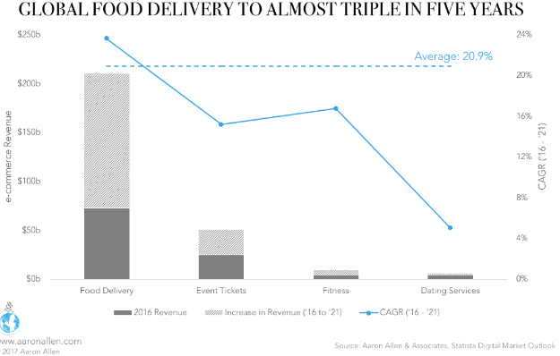
Market Size

Slide 6
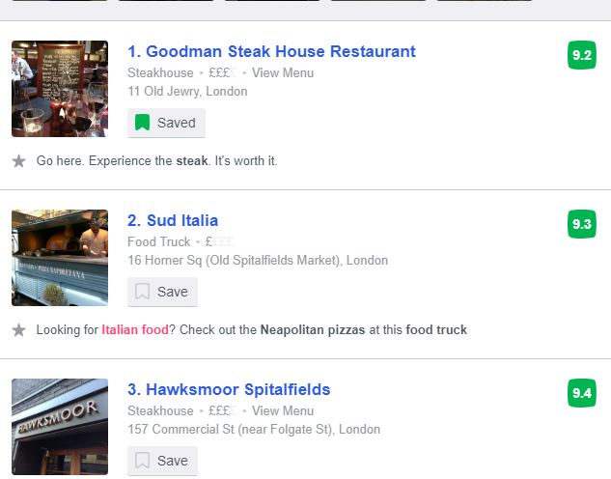
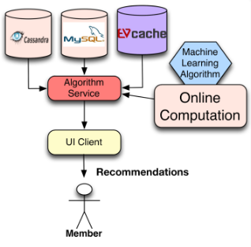
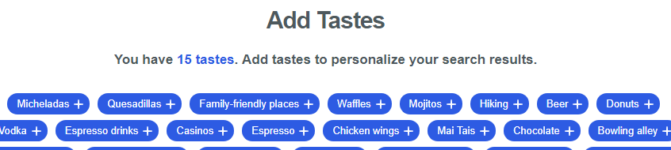
Product
User Preferences Recommendation System Engine Data Presentation

Slide 7
Business Model
SAAS
>Software API licensed product for Companies to integrate with existing site.
Partnerships
>Develop key partnerships with review sites. Usage Based Plan for Sites of all sizes:
-Gold – 5 000 000+ recommendation requests (Page views per month)\Up to 1000 000 Active Users - £1500/month
-Silver – 2 000 000+ recommendation requests (Page views per month)\Up to 400 000 Active Users - £899/month
-Bronze - 100 000+ recommendation requests(Page views per month)\Up to 20 000 Active Users - £100\month
Example: TripAdvisor receives 390 million unique users per month with average of 8 pages per visit.

Slide 8














Market Adoption
PARTNERSHIPS
Travel\Tourist\Review Sites
SUBSCRIPTION\LICENSING MODEL
Companies - Restaurant Chains\Food Guides

Slide 9






Recommendations based on similar customers or own previous behaviour
Competitive
Landscape
Listings & Bookings only – Critics Reviews
Recommendations based on tailoring\Personalisation
Recommendations based on customer reviews only(Ranking System)

Slide 10
Competitive Advantages
Scalable Solution
EASE OF USE
UNIQUE PRODUCT
Cloud based always on based solutions available from mobile and pc devices. Big Data Infrastructure – service can de delivered independent of website traffic
API Functions with existing websites and Easy to customize for businesses
Technology extends beyond reach of existing software and methods. Continuous Improvement of service.

